Slide 1
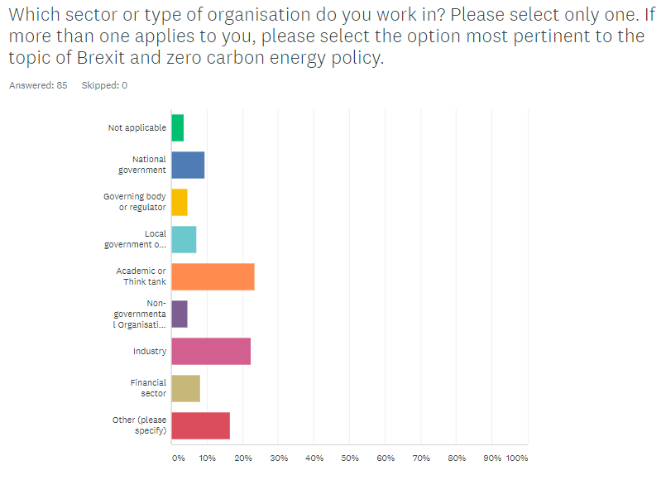
Q1 (n=85, all)
ANSWER CHOICES– | RESPONSES–
–Not applicable | 3.53% 3
–National government | 9.41% 8
–Governing body or regulator | 4.71% 4
–Local government or Devolved administration | 7.06% 6
–Academic or Think tank | 23.53% 20
–Non-governmental Organisation (NGO) | 4.71% 4
–Industry | 22.35% 19
–Financial sector | 8.24% 7
–Responses Other (please specify) | 16.47% 14
TOTAL | 85
Notes:
Other responses:
- Semi state utility
Research
Private consultant and research
- Trade Association
- PR
- Consulting
- Trade Association
- Parliament
- Consultancy
- independent arbitrator
- In this context, I provide volunteer input for a loose collection of energy system analysts. The European Commission characterize us as a "informal organization" for public consultation purposes.
- Independent consultancy with significant innovation projects in the public sector
- De-cabonizaion project developer
- EU institutions

Slide 2
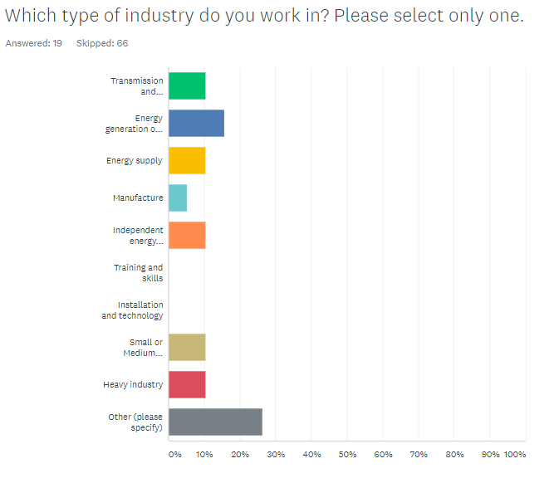
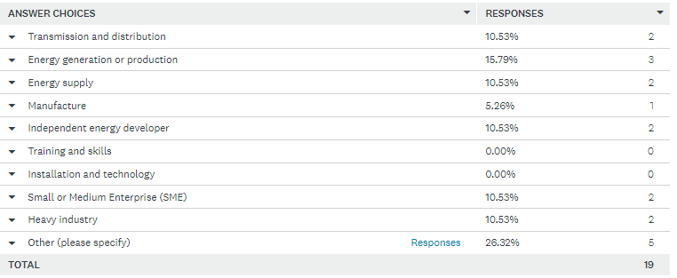
Q2 (n=19, only those who selected Industry in Q1)
Notes:
‘Other’ responses:
Energy transition
Multi-sector Industry Body
Energy policy consultancy
Trade association
Oil, gas and petrochemical company

Slide 3
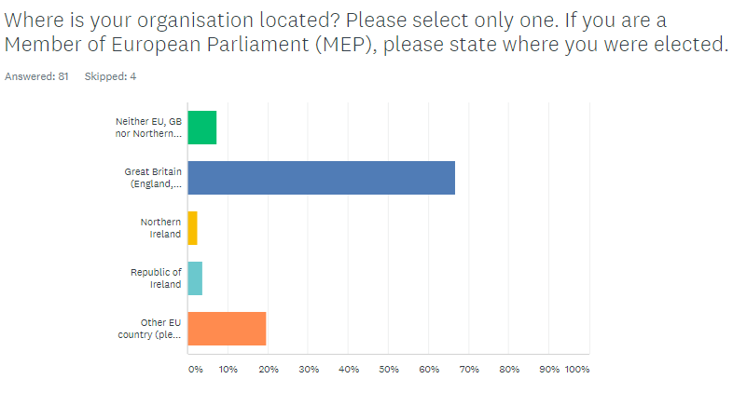
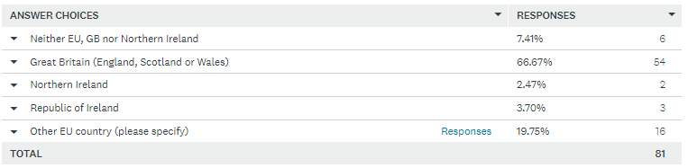
Q3 (n=81, all)
Notes:
‘Other’ responses:
Italy (1 respondent)
Belgium (7 respondents)
Greece (1 respondent)
Switzerland (2 respondents)
France (1 respondent)
Ireland (1 respondent)
Germany (2 respondents)
Poland (1 respondent)

Slide 4
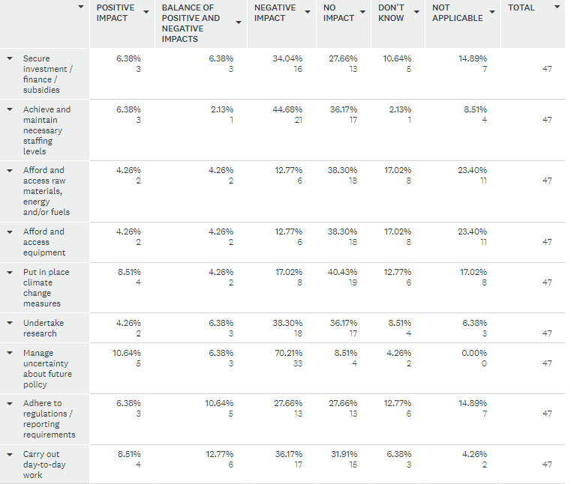
Q4: What overall impact has Brexit had on your organisation, group or team’s ability to: (n=47, UK respondents only)

Slide 5
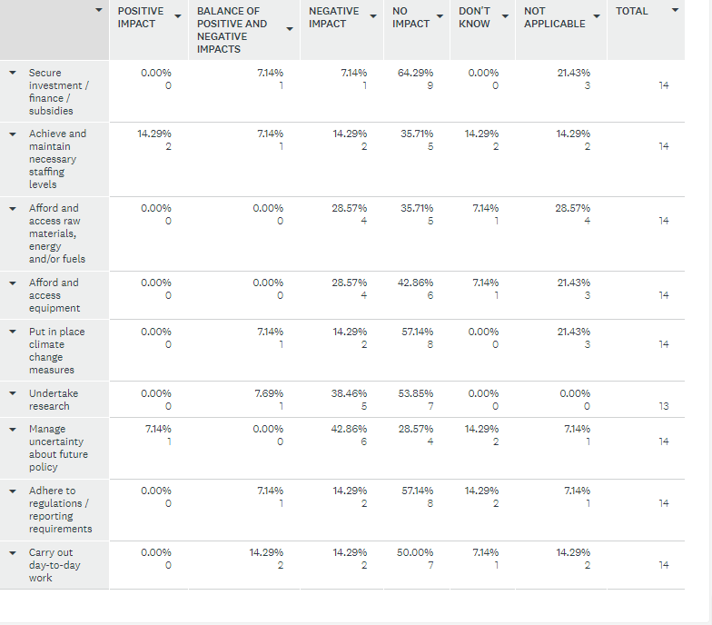
Q5: What overall impact has Brexit had on your organisation, group or team’s ability to: (n=14, EU respondents only)

Slide 6
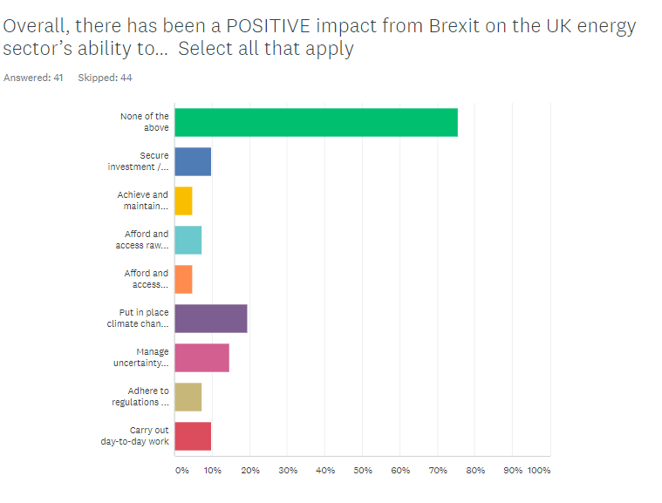
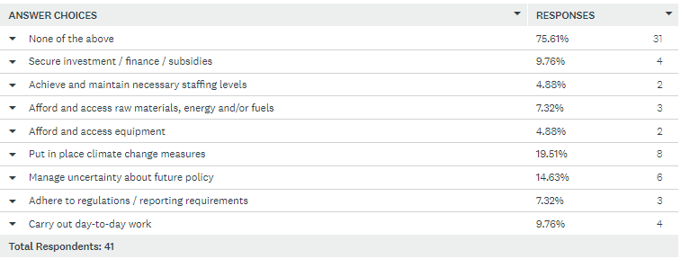
Q6 (n=41, UK respondents only)

Slide 7
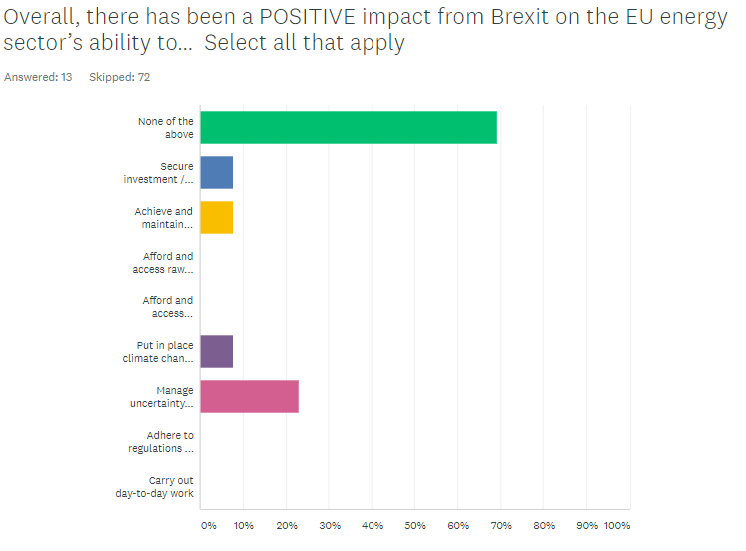
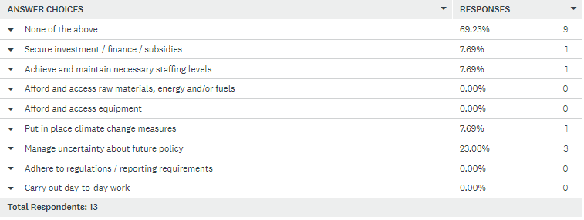
Q7 (n=13, EU respondents only)

Slide 8
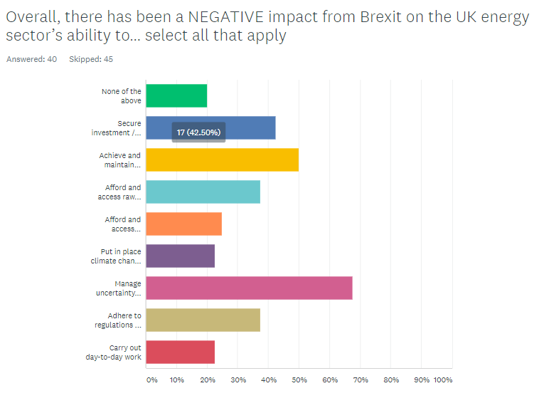
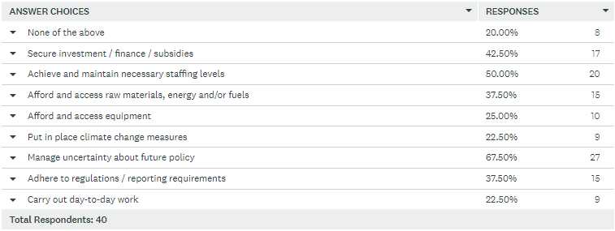
Q8 (n=40, UK respondents only)

Slide 9
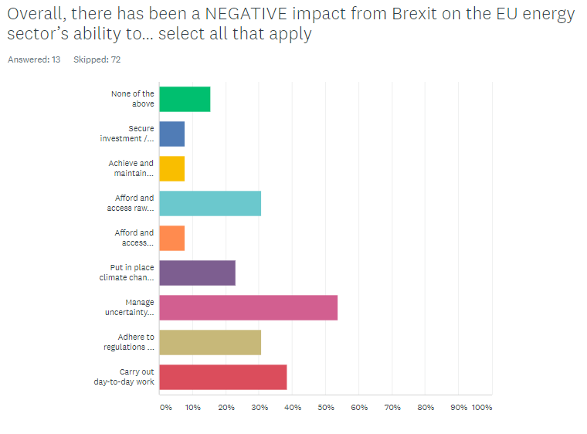
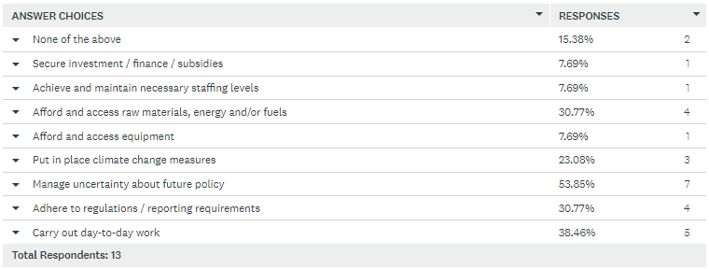
Q9 (n=13, EU respondents only)

Slide 10
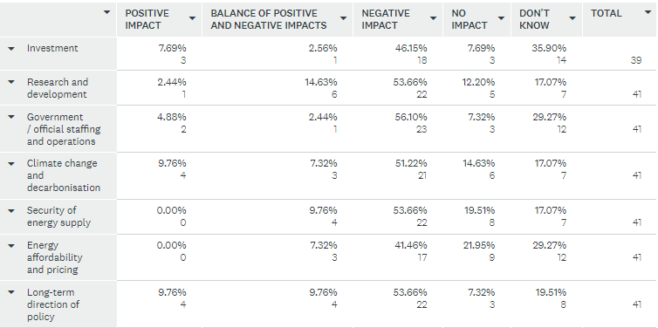
Q10: What overall impact do you think Brexit has already had on different areas of UK energy policy? (n=41, UK respondents only)

Slide 11
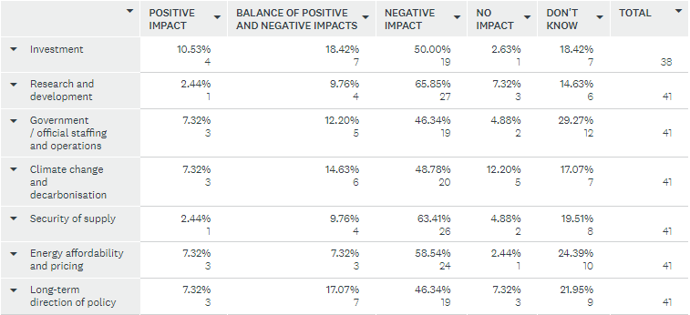
Q11: In the next three years, what overall impact do you think Brexit will have on different areas of UK energy policy? (n=41, UK respondents only)

Slide 12
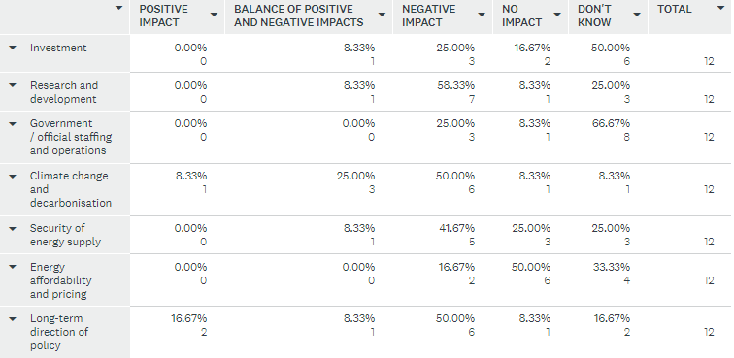
Q12: What overall impact do you think Brexit has already had on different areas of EU energy policy? (n=12, EU respondents only)

Slide 13
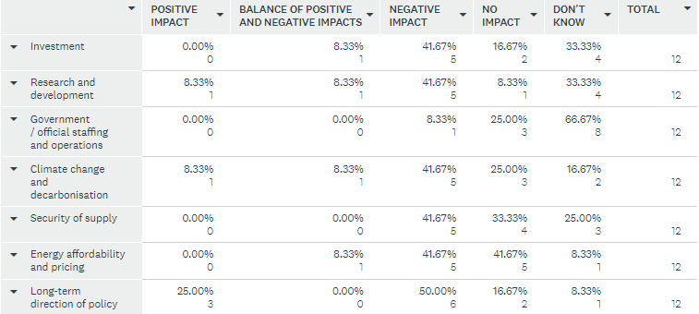
Q13: In the next three years, what overall impact do you think Brexit will have on different areas of EU energy policy? (n=12, EU respondents only)

Slide 14
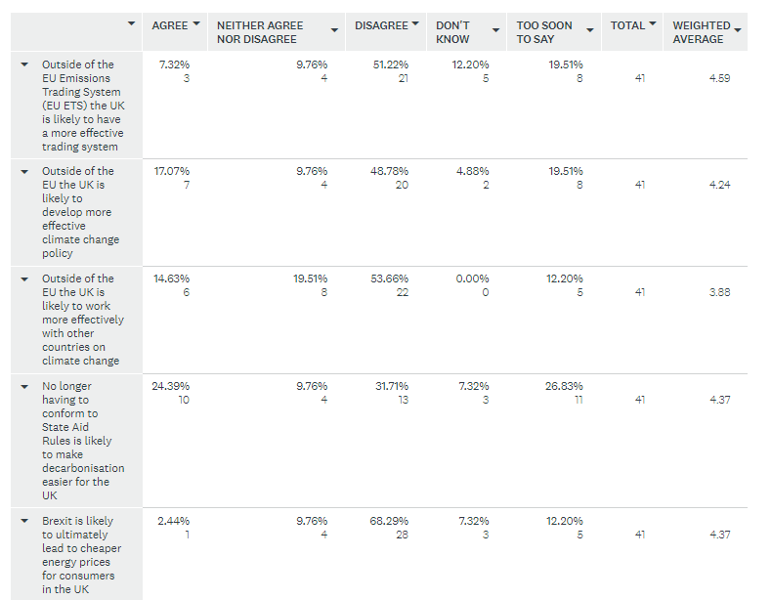
Q14: To what extent, if at all, do you agree with the following statements? (n=41, UK respondents only)

Slide 15
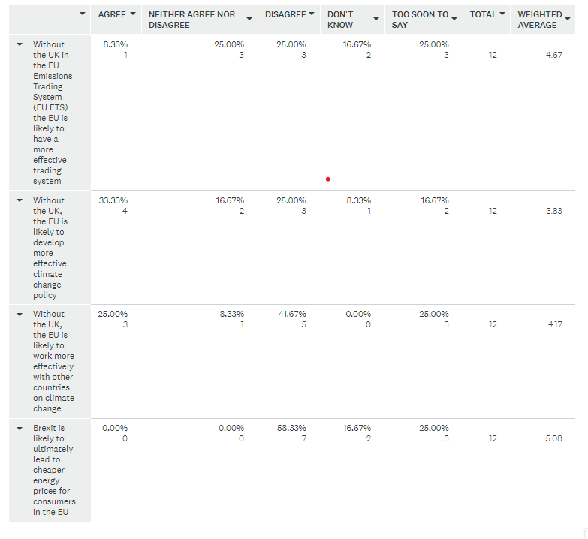
Q15: To what extent, if at all, do you agree with the following statements? (n=12, EU respondents only)

Slide 16
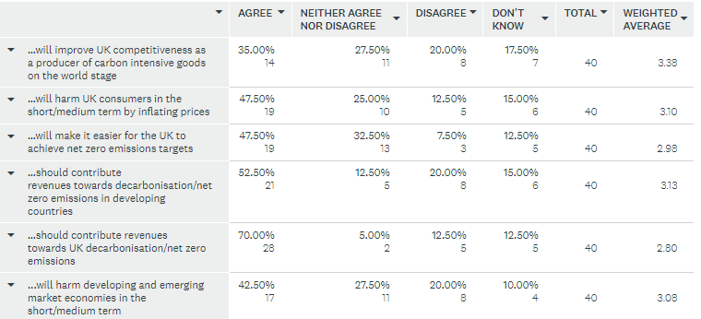
Q16: To what extent, if at all, do you agree with the following statements? (n=40, UK respondents only)

Slide 17
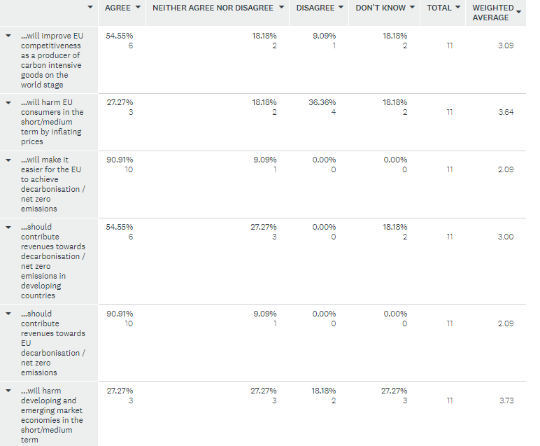
Q17: To what extent, if at all, do you agree with the following statements? (n=11, EU respondents only)

Slide 18
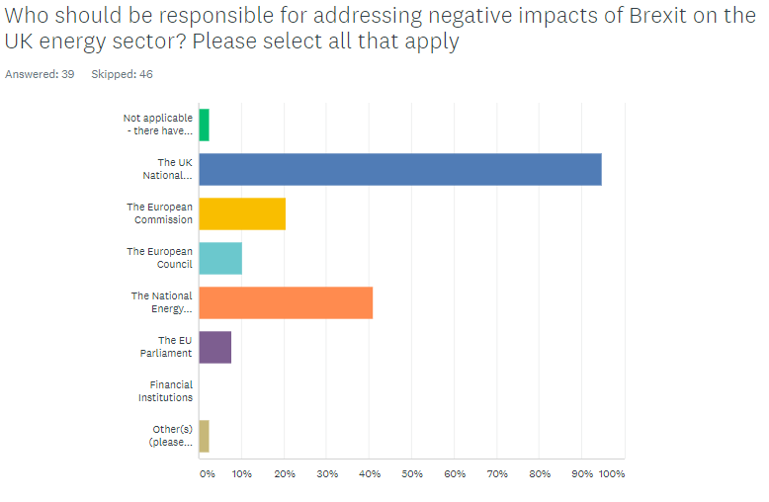
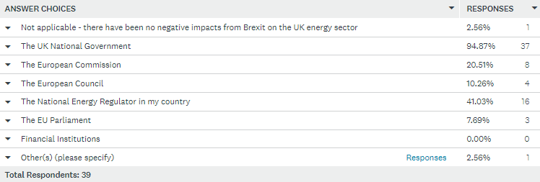
Q18 (n=39, UK respondents only)

Slide 19
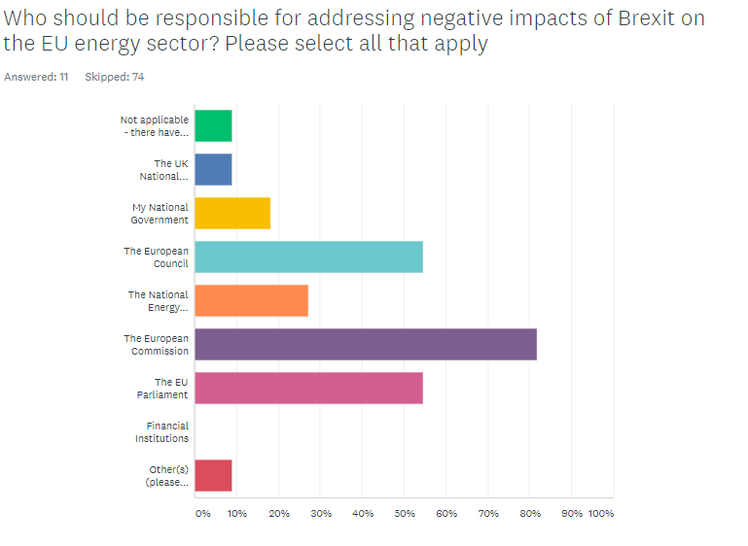
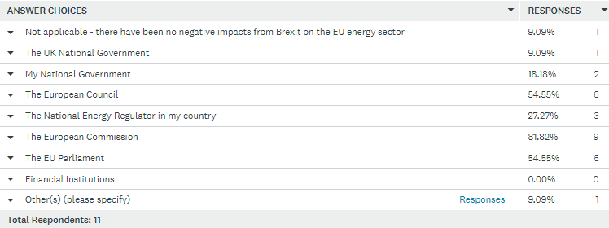
Q19 (n=11, EU respondents only)

Slide 20
Q20: What support would help your organisation in managing any negative impacts of Brexit? (n=30, UK respondents only)
Not applicable (11 respondents)
Fixing immigration problems that make it hard for international staff and students (including those who were formerly considered “home” as EU citizens) to work or study at my university.
Access to funding to SMAs
Action to make recruitment of EU nationals and access to EU research funds as straightforward as it was before Brexit
Clarity about the roles of different UK research and innovation support bodies and programmes. Clear and effective UK carbon reduction policy and taxation measures. Training of more energy and engineering professionals.
Greater EU-UK cooperation on energy and climate policy, energy and goods trading, and movement of skilled workers
Not directly relevant to my organisation but the UK and EU need to press ahead with the specialised committee on energy (set up under the Trade and Cooperation Agreement which will agree the new arrangements for the efficient trading of electricity across interconnectors).
Clear support for domestic manufacturing and greater self-sufficiency in energy saving products.
Research cooperation on the impacts of Brexit
EU recognition of UK commodity exchanges and clearing houses linking the UK ETS to the EU ETS
It is the negative impact of Carrie Johnson and her useless spouse, that is the problem. Between Covid, wokeness, immigration, and their idiotic climate change policies, they will destroy the country. This has nothing to do with Brexit.
Understanding long-term policy direction and support to influence the policy direction. Devolved powers
Some more "adventurous", capital for world scale projects In developing countries. PPP structures, and full feasibility study support to FID. There are "good investors".. PIDG, CDC, etc.. but I don't think anyone would describe them as adventurous or even ambitious. They are in the grip of well established administrative processes. Just like the case for a Green Bank in the UK back in 2000 or so - if very different results are required (in this case net Zero on a demanding timescale) then differently purposed and staffed institutions are necessary. As with the Green Bank, the UK could take a lead
Continued on next page…

Slide 21
The UK government focusing on rebuilding a constructive political relationship with the EU, so that the energy title of the TCA (which is a good basis for a new relationship) can be implemented effectively
Support for covid recovery is already driving the economy so that impact of Brexit is very hard to assess
Better resourced UK Reach system and clearer guidance
The UK government should support financially to those who have projects to build
Interpretation of legislation coming from DfW and EU task force on climate related regulation and legislation
Clear NI protocol arrangement (although even today an announcement was made indicating a restructuring of the agreement may occur). Can objectively, impartially state, without supporting Brexit or not, Northern Ireland has been left behind in the current arrangements
Ensuring existing domestic manufacturing/energy intensive industries receive full carbon leakage protection

Slide 22
Q21: What support would help your organisation in managing any negative impacts of Brexit? (n=9, EU respondents only)
Not applicable (6 respondents)
Good dialogue
Greater ability to move skilled staff between UK and EU (company HQ is Germany but there are significant operations in UK as well as EU). Sorting out customs and logistics issues affecting supply of materials and parts to UK plant
I am concerned that public-interest energy sector data standards will diverge more than without Brexit as each jurisdiction travels its own road. Anything that can help coordinate those efforts is to be welcomed

Slide 23
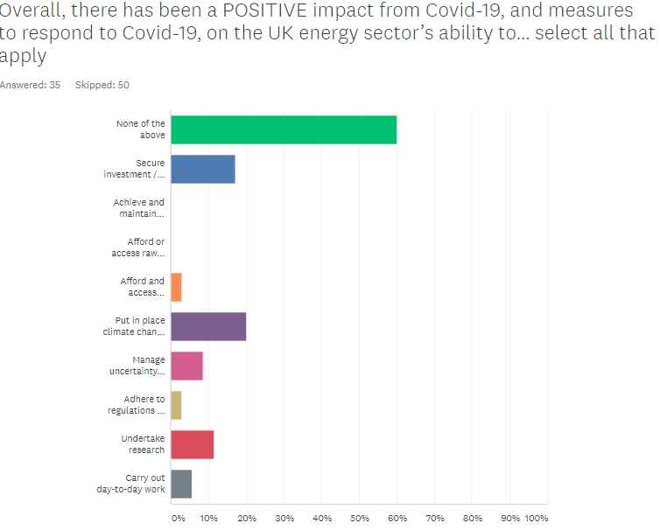
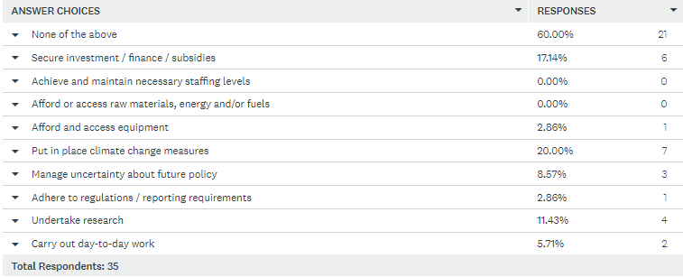
Q22: (n=35, UK respondents only)

Slide 24
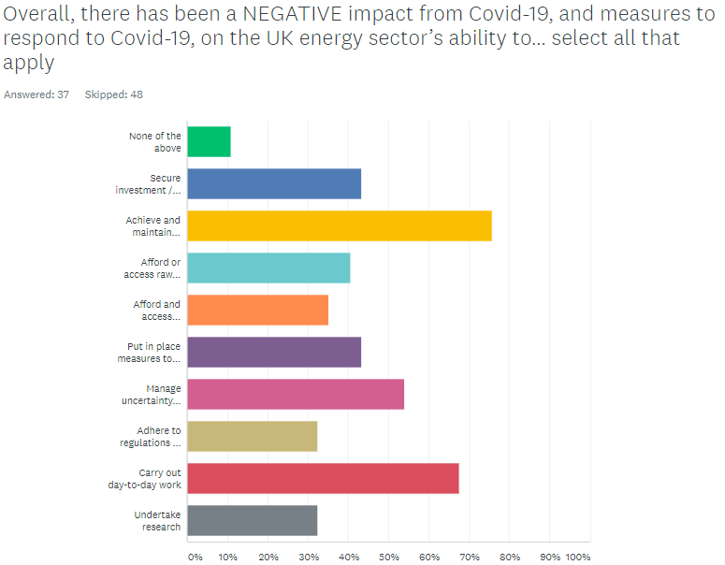
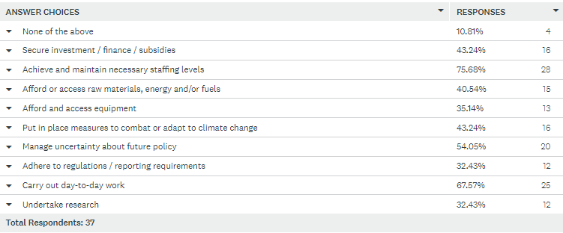
Q23 (n=37, UK respondents only)

Slide 25
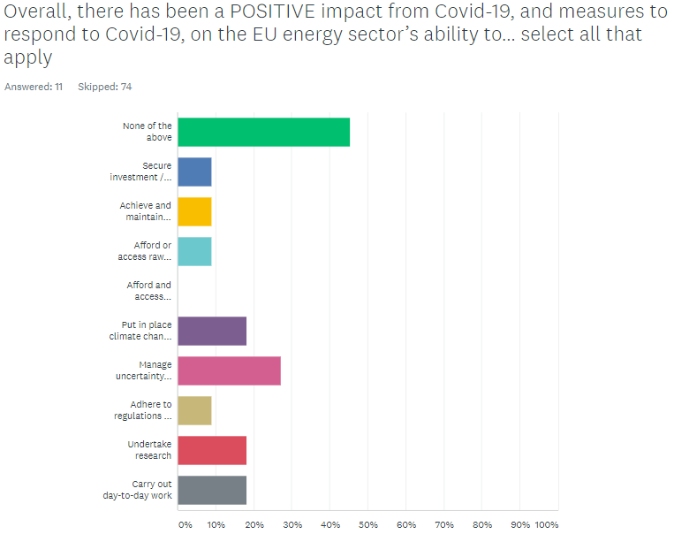
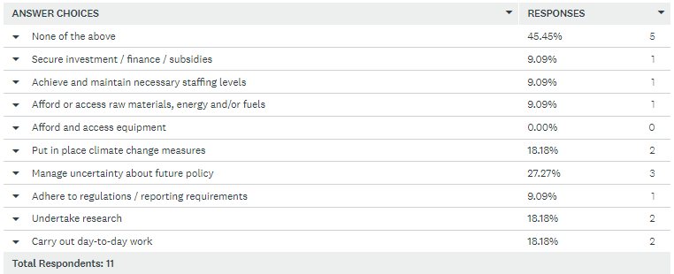
Q24 (n=11, EU respondents only)

Slide 26
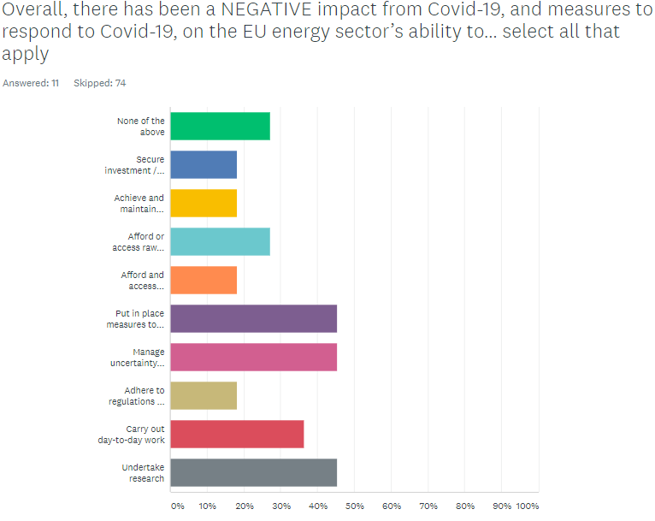
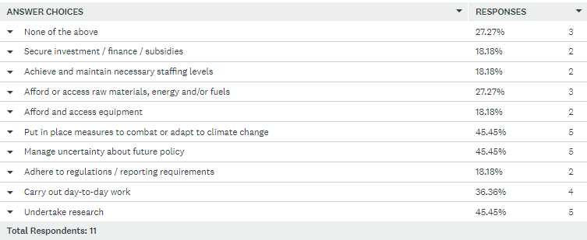
Q25 (n=11, EU respondents only)

Slide 27
Q26: Do you have any further reflections on how Brexit has impacted the UK and energy sectors and energy policy? (n=27)
The uncoupling of the GB bidding zone from the single-day market due to Brexit is a pity. It is a pure technical arrangement, yearly millions of euros are lost in inefficiencies due to the new (suboptimal) arrangement
I think the EU rules on carbon intensity and IPCC targets on achieving the climate targets are something that UK will be following and therefore it will have little impact on the ESG roadmap followed by UK. Brexit will therefore have little/ no impact.
I think for now the impact has been minimal, at least for policy makers in the field of EU Energy policy. There is huge momentum for ambitious climate legislation right now, and the EU regulators are proceeding with this, Brexit or no Brexit. It's not like the Brexit has added an extra dimension to EU climate policy. Maybe problems will still arise when new legislation is introduced. But even with the CBAM for example I would not expect any trouble, since it is unlikely to affect the UK since they have a UK ETS. And it will likely even make it easier to pass ambitious legislation through the Council without the UK. (think e.g. of the Energy Taxation Directive where unanimity is required etc) So that would be positive impact.
Depending on future UK governments, it's possible that being able to act freely alone may allow the UK to decarbonise faster/better than the EU. But the impact of this will be limited compared to the EU hypothetically doing better thanks to UK influence as a member.
The UK has been unconstrained in its ability to address energy and decarbonisation policies rather than having to wade through the minefield of 27 different views
Brexit has damaged long-term planning on both sides and increased perceptions of instability at a time when energy sectors need to be transforming urgently to decarbonisation. It has been a distraction that has diverted some funding and caused damaging delays leading to further entrenchment of outdated modes of functioning in the energy sectors.
It is too early to have a comprehensive understanding of the impact of Brexit on the energy sector and policy as it combines with the still ongoing covid crisis, but an aspect will probably be to facilitate the UE initiatives and actions in the field, following the Green Deal and the recent Commission's initiatives, even if the way forward is certainly going to be very difficult.
It has made what was already complex even more so
Free workshops and conferences for EU funding programmes presented good networking and learning opportunities. Having to approve fees makes attendance problematic: We are attending events to learn, but are expected to apply for fees approval setting out in advance what we would gain. If we knew already we should not be attending!! Catch 22

Slide 28
My main reflection is that Brexit related work has taken up a huge amount of time (particularly government's) which has no doubt had an impact on other policy development.
Strong cooperation needed on product standards across European countries to avoid obstacles to development .
It may give greater impetus to North Sea offshore renewable energy cooperation given that it is a specific focus in the TCA (but that is a big "may").
UK has been instrumental in the development of the single energy market, emissions trading and decarbonisation. The UK's absence from the EU undermines the development of both UK and EU energy and carbon markets which makes decarbonisation and energy security less efficient and more expensive for consumers. The sooner the two markets can be recombined, the better.
Brexit is not the issue, the idiotic Zero Carbon virtue signalling and Carrie Johnson are the problem.
The current UK government is shorter on capabilities and competencies than many of its predecessors. Particularly on strategy and convening-power. COP26 is in danger of becoming a missed opportunity. Which would be a very black mark for the UK and its fragmented leadership - and potentially a disaster for he world.
One of the principal activities my business is engaged in is the development of UK to continental Europe electricity interconnectors. Despite both UK government and the EU energy policies supporting additional interconnectors, Brexit has added complications to their development and regulation. Investors are, understandably, more cautious in an uncertain environment which is delaying and possibly halting some project developments.
Energy and climate policy is a area where there is a significant regional interest. We share effectively the same climate targets as European neighbours, we should be linking the UK ETS to the EU to maximize liquidity and cost-effective decarbonisation, and to avoid a CBAM creating trading barriers between the UK and EU. We need to co-operate in the North Sea to build large scale offshore wind and the connecting grids. Our supply chains for clean energy are trans-European. It is essential that the UK and the EU establish an effective way to co-operate on energy and climate so that we can meet our mutual net zero target.

Slide 29
Linking the EU & UK ETS will facilitate decarbonisation for both the UK and EU
There will doubtless be increasing divergence from the single energy market concept, with downsides for climate protection. That said, Germany and the UK just announced an electricity connector, to be completed by 2024. But these more ad-hoc arrangements are unlikely to be as effective as deeper coordination.
I think there has been a limited positive effect in stimulating recognition of the need to think more independently and creatively about energy policy, and particularly about the overlaps between energy policy and industrial policies. However, I think it is too soon to say whether this will have any real impact or is merely bluster and dissembling. It is a tragedy that both Brexit and Covid seem to have been necessary to stimulate such (potential) mindshifts, when there were actually no regulatory or legal reasons why the UK government and policy community couldn't have worked in these ways previously.
The UK government should support those companies who have decarbonizion projects to build
Despite Brexit, a collaboration between the UK and the EU is more necessary than with the U.S, because of geography. It would be easier for the rest of the world to follow the example of a continent than a country. Also, Brexit has severed any financial help that could be offered by the EU, especially as the government would need to pump billions, if not trillions into green projects and reforms. These will not reap any obvious benefits till years down the line. With fewer close allies to help, this government, and maybe the next one or two, may lack any courage to carry out any green reforms they claim is so important.
Northern Ireland has a unique situation as a devolved government in the UK - NI is not on the national grid, but rather connected to the all-island Single Electricity Market, which operates across both UK (Northern Ireland) and EU (Republic of Ireland) jurisdictions. Therefore, in relation to energy, NI is unique in the UK in that some EU and UK rules apply. The risks that this creates needs to be understood further and addressed.
Brexit is still yet a question mark in terms of relationship between the continent and UK. A lot of data is misleading due to Covid and we will need to wait until things clear up to understand the real impact of Brexit. We will need to make flag a number of factors that will certainly have an impact on EU and UK economies such as (i) Security of Supply, (ii) carbon emissions (including carbon emissions trading), (iii) other commodities that are directly impacted by carbon emissions reduction such as nickel, aluminium, iron ore, etc. The UK is still very much dependent on EU energy imports. A transformation of consumption and production is under way, but a more detail analysis will be required to understand the impact of the supply alternatives and how dynamic is the demand. In order to produce energy from non fossil fuel energy other commodities (in addition to investment) is required. Are there enough investments in such field? Who competes for the aluminium required to make EV? Who will have the latest technology to produce the EV? Will enough power be generated during peak times? Is the security of supply guaranteed (either carbon neutral or through fossil)?
I think Brexit has been a catastrophic mistake across the board, especially with the current incompetent UK government in charge.

